Slide 1
Telecommunications customer churn
LOGISTIC REGRESSION MODEL
SHELLEY LEUNG
Notes:
Hello Everyone,
My name is Shelley and I am presenting a Logistic Regression Model.
Today, our topic is on Customer Churn at a Telecommunications company and I will be doing a predictive analysis.
Let’s get started.

Slide 2
AGENDA
Introduction
Research Question & Goal of Analysis
Model Assumptions
Procedures & Code Demo
Compare Model 1 and Model 2
Recommendations
Notes:
The agenda for today are the following:
First, I will introduce the scenario.
Then I will mention the research question and the goal of this analysis.
Then I will talk about the procedures done for this model and show a code demonstration.
I will also explain the LR model assumptions
And do a comparison of two different model types.
Lastly, I will summarize some suggestions.

Slide 3
INTRODUCTION
What is Customer Attrition?
Why is it important?
Notes:
Companies have a critical focus on customer relationship management because it directly impacts the company’s long-term profitability and the amount of costs that accrues when customers stop the business relationship. Customer attrition, also known as churn, is a metric that determines the rate in which a customer chooses to stop a relationship with a business. Customer churn is an important metric companies invest in because it researches and helps leaders of the company understand the underlying reasons why consumers choose to leave for a competitor.

Slide 4
RESEARCH QUESTION
What characteristics in the customer’s profile correlates to their churn?
Why do we need to know this information?
Notes:
In this research process, a dataset of 10,000 customer profiles have been obtained to acquire insights related to customer churn and to build a predictive model to select features that correlate to churn. The proposed research question in this analysis is:
What characteristics in the customer’s profile correlates to their churn?
This is the goal of this study because understanding a customer’s point of view can help the organization learn what are the underlying causes for customers to terminate their business relationship with the company. Concurrently, it also helps the organization understand what are the attractive aspects that make a customer stay. Knowing this information can help a company improve on certain services for their customer, while maintaining the quality of service that has aided customer retention.

Slide 5
PROCEDURE
Create a data frame and explore the dataset with relevant variables to the research question.
1
Explore numerical variables and transform them into categorical variables. Explore and understand the categorical variables in the dataset.
2
Test for collinearity prior to building the logistic regression model.
3
Pre-process data, train test split, build model with sci-kit learn library.
4
Evaluate the model from the three assumptions made for logistic regression.
5

Slide 6

CODE DEMO
Notes:
For our predictive model, I used Python 3.7 and Jupyter notebook to develop and code the model and analysis
a demonstration of the functionality of the code used for the analysis

Slide 7
Logistic regression model assumptions
Outcome variable is binary.
Test of Multicollinearity: All input variables must be independent of each other.
All observations in the dataset are independent of each other.
Notes:
Outcome variable is Customer churn (Yes, No).
Multicollinearity test was performed in the procedures with a correlation matrix heatmap. There are no collinear variables.
All observations are confirmed to be independent because each customer ID provided are unique in the dataset.

Slide 8
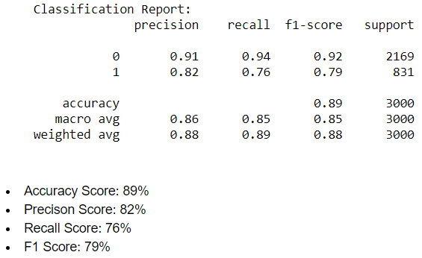
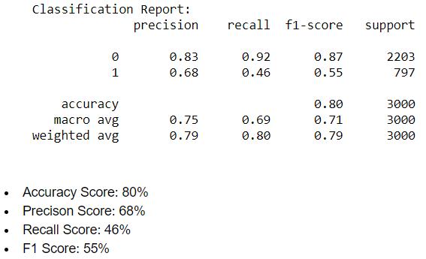
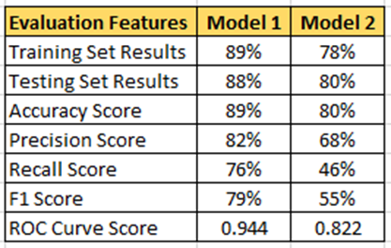
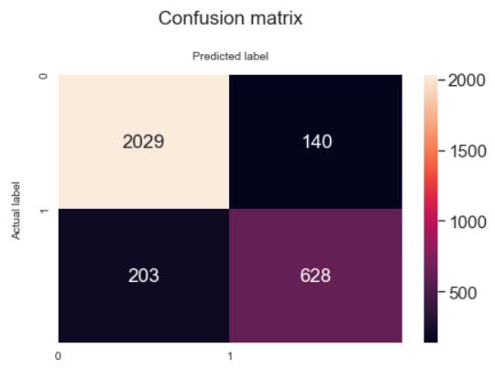
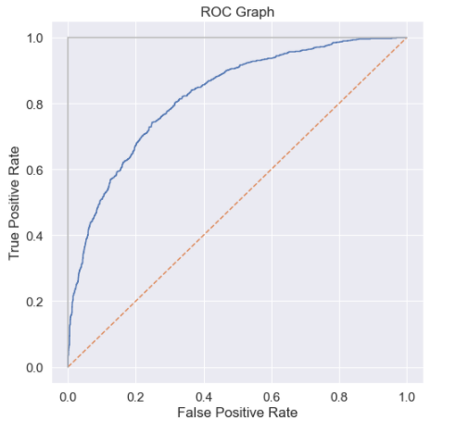
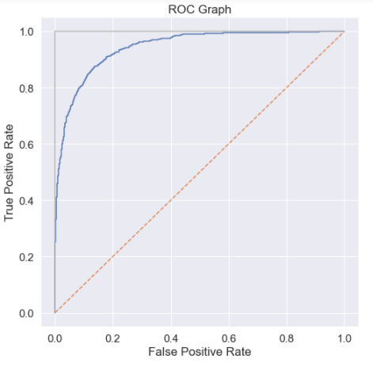
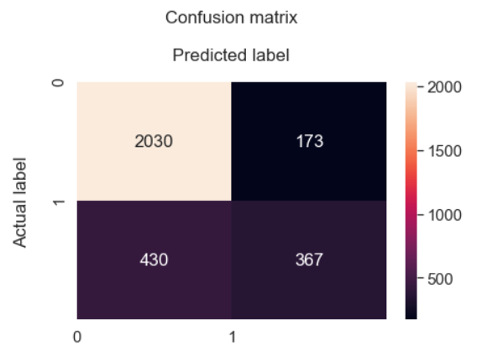
MODEL COMPARISON
MODEL 1: 25 Variables
MODEL 2: 12 Variables
Notes:
Both models were validated and tested based on the assumptions discussed earlier.
View Training and Testing Set results. Model 1 is higher which means this model has a higher true positive/negative rate.
Model 1 has a higher accuracy score as a result of the true positive/negative rates.
Precision, Recall and F1 scores all demonstrate the model’s performance metrics. Model 1 has higher performance in all aspects compared to Model 2.
The ROC curve score, measures the performance of the classifier, is very high at 0.94, which is 0.12 points higher than model 1.
In this comparison, Model 1 is more effective.

Slide 9
recommendations
Contracts & Tenures were the biggest factors to customer churn. Proposing longer contracts instead of month-to-month can increase tenure and lower chances of customers leaving.
Quality of products offered were not as attractive to retain customers. Many customers with streaming TV, streaming movies, phone lines and internet services tend to leave at a faster rate. Improving the product experience and pricing range can help retain customers.
Lack of tech support has contributed to customers leaving. Based on the data, there are a good amount of not tech savvy customers and/or senior citizens. Investing into a good tech support team for the customers can improve the experience and allow customer to use the company products to its full potential.

Slide 10
THE END
Notes:
That is the end of my presentation. If you want to understand more in-depth, I have written a paper that further expands on the details. Thank you for listening

